Slide 1


CanSat 2024 Preliminary Design Review (PDR)
TEAM PHOENIX
2024-ASI-CANSAT-012

Slide 2
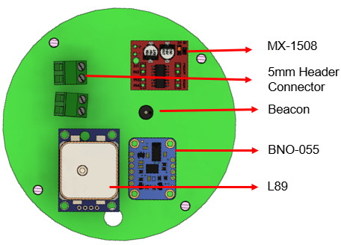
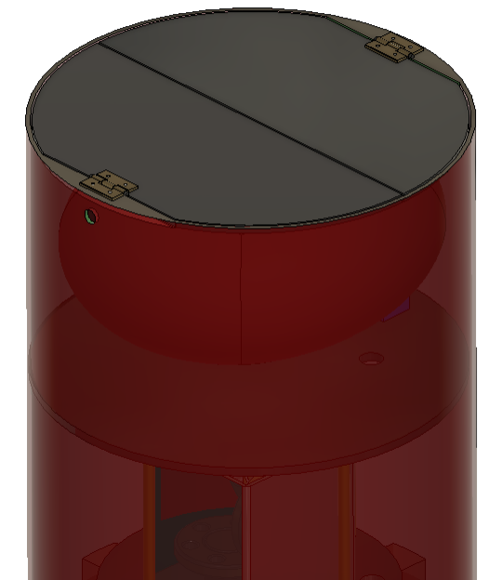
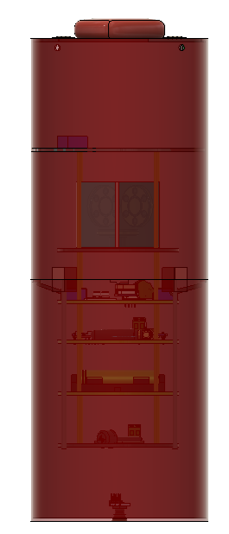
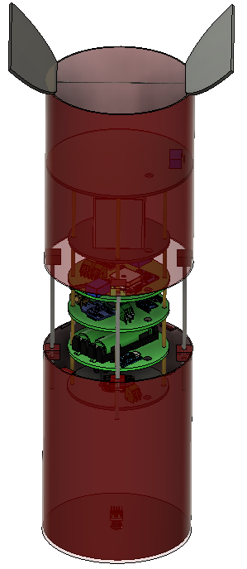
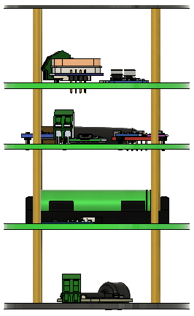
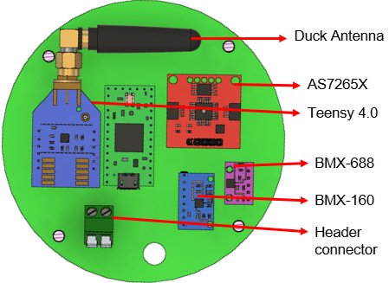
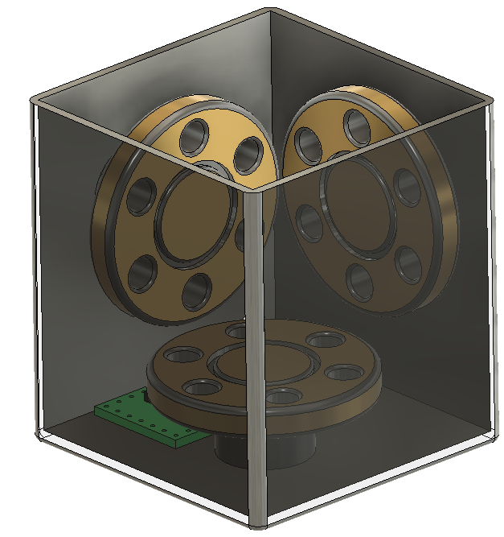

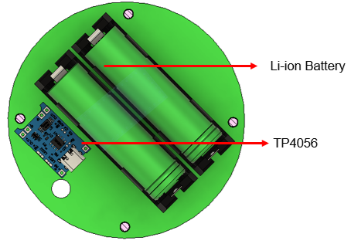
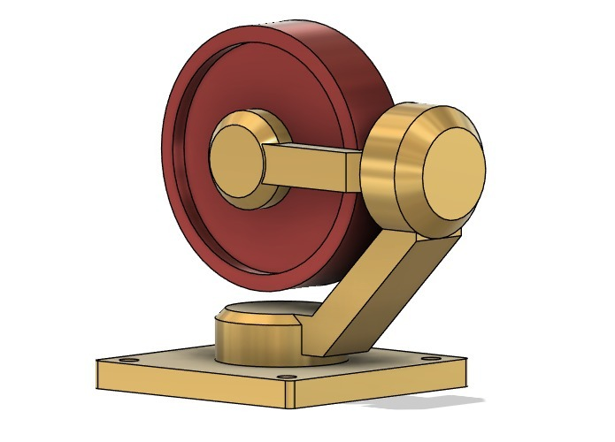
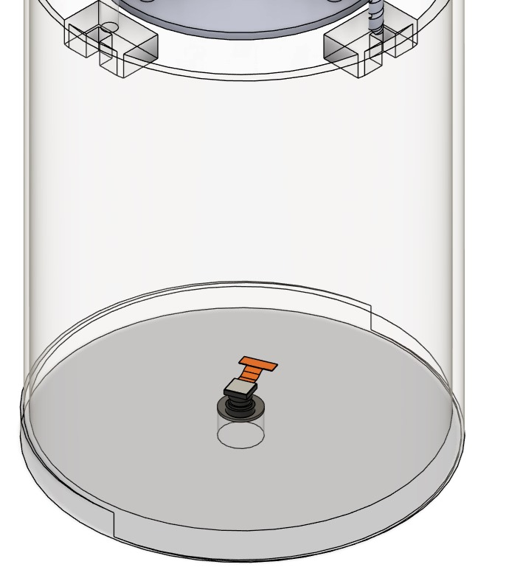
CANSAT configuration
Top Lib Opened
Parachute Section
1st Circular PCB
2nd Parachute deployed
Gyro
392MM
(Or)
2nd circular PCB
Payload
Camera
147 MM
3rd Circular PCB

Slide 3
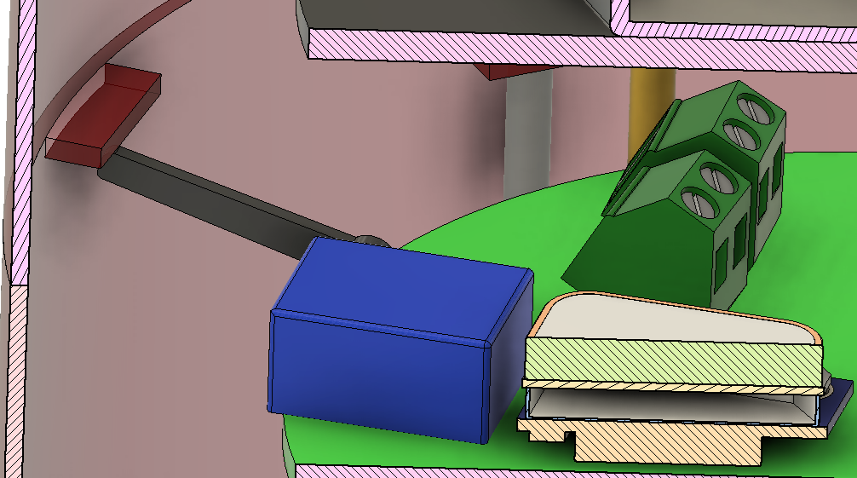
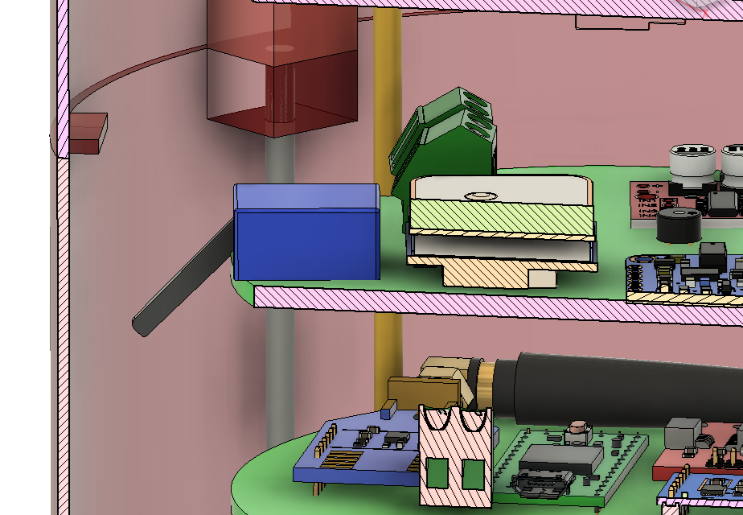
Innovation adopted by your team
INNOVATION
Automatic Expansion: CanSat expands at a specific altitude (475m).
Direct Atmosphere Exposure: Sensors exposed immediately for accurate readings.
Teensy Control: Teensy processor automates servo and lock mechanisms.
Compact Design: Expands only when needed, saving space.
Efficient Data Collection: Real-time atmospheric data at a critical altitude.
locked position
Unlocked position
The CanSat still in contracted state from 1000 m to 475 m of altitude.
The CanSat in the retracted state after the altitude of 475 m.
Launch
Altitude Check
Servo Trigger
475m Detected
Expansion
Data Collection

Slide 4
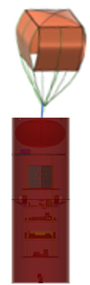
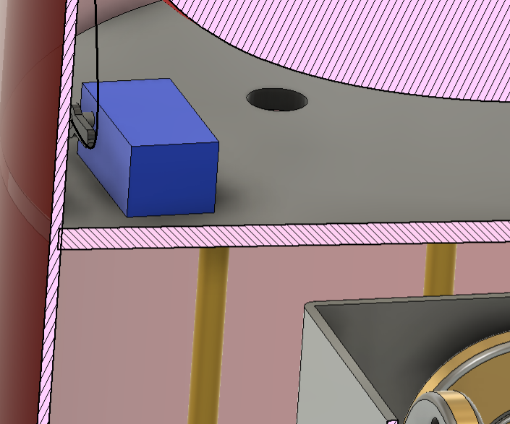
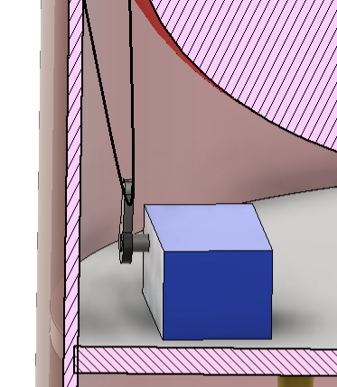
CANSAT descent control mechanism
The first parachute deploys when the CanSat is released from the rocket
The first parachute deploys when the Cant is released from the rocket
At 475m altitude, the servo releases the lock, allowing the outer shell to retract downward.
The first parachute deploys when the sed from the rocket
The first parachute deploys when the CanSat is released from the rocket
locked position
At 500m altitude, the second parachute deploys using a servo lock mechanism.
The first parachute is folded on the CanSat's top lid and unfolds due to air resistance, reducing the descent velocity to 15 m/s
Expansion Mechanism
Unlocked position
The parachute reduces the descent rate to 2 m/s.
Deployed from Rocket
1st Parachute Deploys
1000 m
2nd Parachute Released
500 m
Expansion Mechanism Triggered
475 m
1st parachute deployment Mechanism
2nd parachute deployment Mechanism
CanSat Reaches Ground
0 m

Slide 5

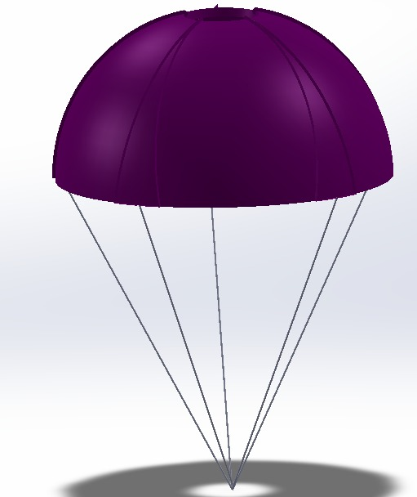
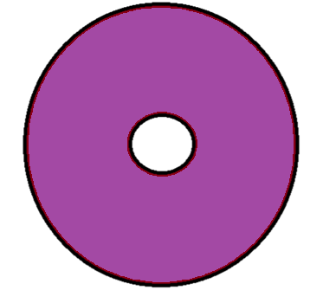

Parachute design and sizing
CUBE PARACHUTE
- Primary Parachute
Stability: Offers better stability during descent due to its box-like shape, reducing oscillations.
Compact Design: Easy to fold and store, making it space-efficient for deployment.
Descent velocity = 15 m/s
Weight = 0.85 kg
Area = 13.71 cm
Material Used = Nylon
Colour = Fluorescent Orange
13.71 cm
Velocity - 15m/s
41.13 cm
Hemispherical with spill hole - Secondary parachute
8.8 cm
Improved Stability: The spill hole design reduces instability and oscillations, allowing for a more controlled and stable descent.
Improved Control: The spill hole helps regulate descent speed and reduces jerking, offering more precise control over the landing process.
Descent velocity = 2 m/s
Weight = 0.85 kg
Area = 2.522 $m^{2}$
Diameter = 1.263 m
Hole = 7%
Material Used = Nylon
Colour = Voilet
126.8 cm
Velocity - 2 m/s

Slide 6
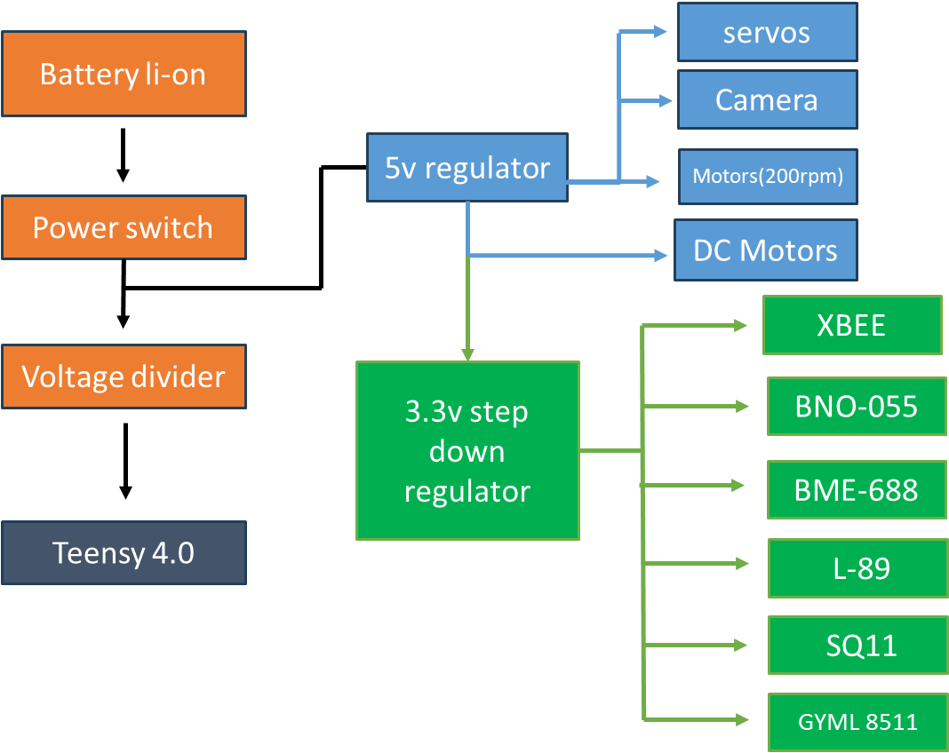
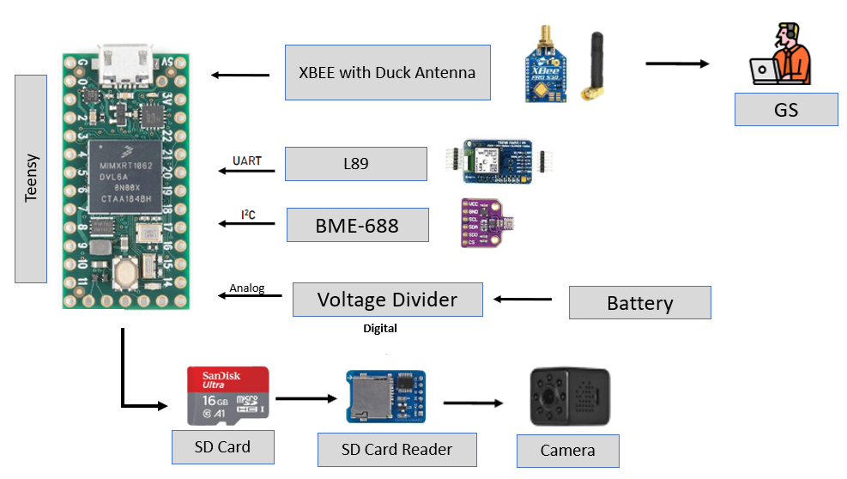
CANSAT avionics systems
DC Motor
AS7265x
BMX160
Power subsystem block diagram
Communication subsystem block diagram

Slide 7
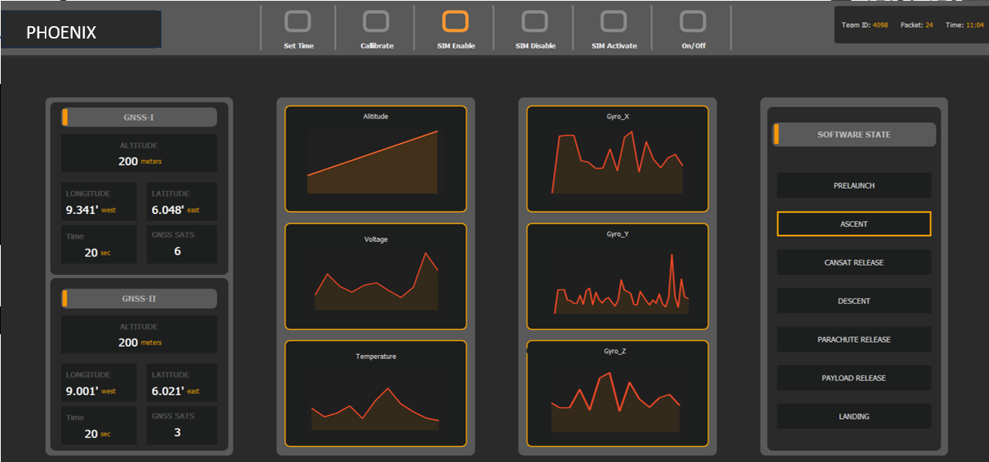
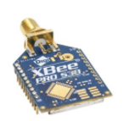
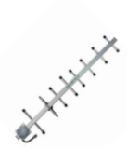
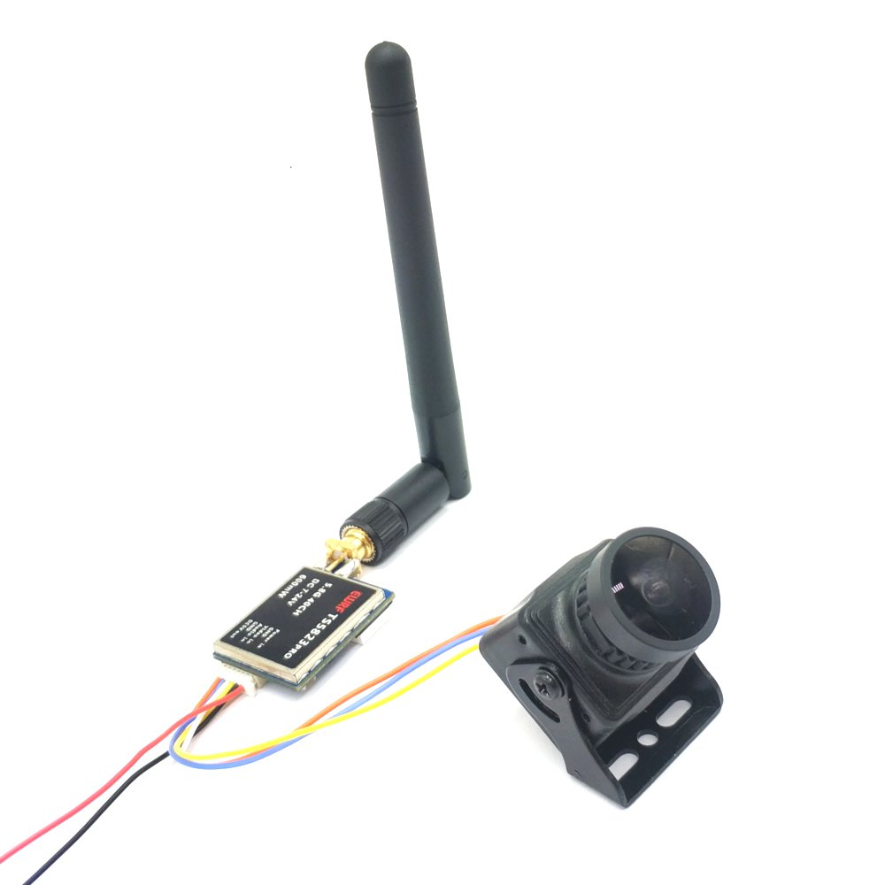
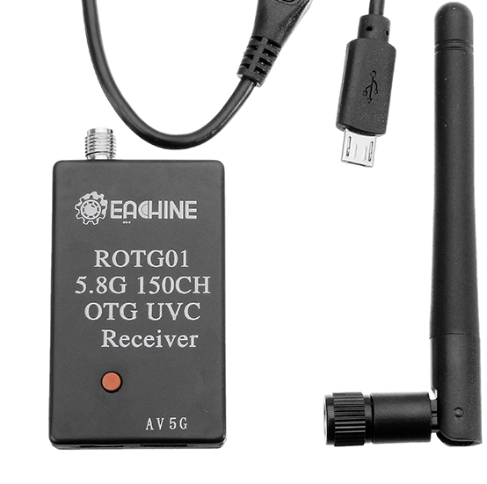

CANSAT mission control software and ground systems.
Overview of Mission Control Software
Ground Systems
Programming Language:
C/C++ for payload hardware
Python for ground station
Development Environment:
Visual Studio Code
Digi XBEE pro - 900 MHz transmitter
Yagi antenna 900MHz (receiver)
Digi XBEE pro - 900 MHz receiever
Mission Control Software Flow map
USB-
ADAPTOR
For live video telemetry:
CanSat Data
Python Script
Data Processing
Telemetry Transmission
Control Logic
Ground Station Dashboard
User Action (if needed)
FPV Camera transmitter
FPV Camera receiver

Slide 8
CANSAT Mass, Cost, Power Budget and Descent Time
Total mass of electrical subsystem (g) | 240.8 g
Total mass of mechanical subsystem(g) | 610 g
Total Mass | 850.8 g
Phase | Height | Descent Rate | Descent Time
1st Parachute released | 1000m - 500m | 15 m/s | 33.7 s
2nd Parachute released | 500m - 0m | 2 m/s | 250
 | Total Descent time |  | 283.7 seconds
Total cost of electrical subsystem | 28217
Total cost of mechanical subsystem | 7379
Total Mass | 35595
Total mAh = 1058
It consumes 1058 mAh of power to function for 1 Hour.
With 2800 mAh battery it can function for 2hrs 35 mins

